Slide 1
CLEF 2016 Task 3 Report
Joao Palotti
palotti@ifs.tuwien.ac.at

Slide 2
Patient-Centred Information Retrieval
1
Topics
2
Collection
3
Assessments
Generated by genuine user questions made on Reddit:
www.reddit.com/r/AskDocs/
6 query variations for each of the 50 information need
50 million of web pages of Clueweb 12B
Terrier and Indri Indices available in Azure platform
Assessments made by experts with respect to:
Topical Relevance
Understandability
Trustworthiness

Slide 3
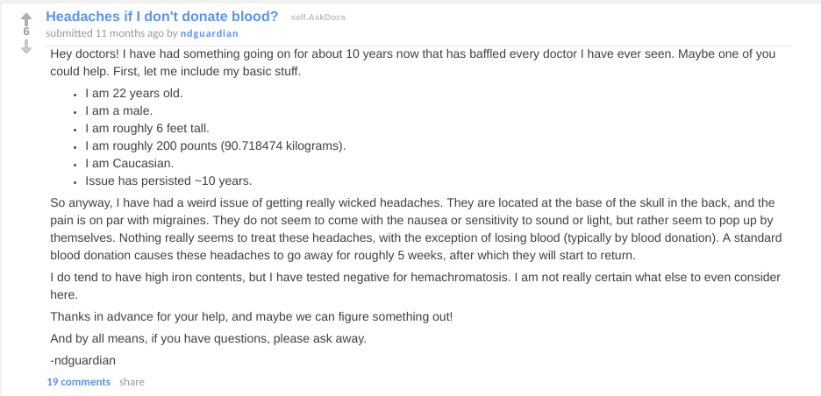
Query Generation
headaches relieved by blood donation
headaches caused by too much blood or "high blood pressure"
high iron headache
headache that only goes away with blood loss
blood donation headache reduction
what causes strong headaches at base of skull, stops with blood donation

Slide 4
IRTask 1 - Ad-hoc Retrieval
300 queries: One ranked list for each query.
….
<query>
<id> 103001 </id>
<title>headaches relieved by blood donation</title>
</query>
<query>
<id> 103002 </id>
<title>high iron headache</title>
</query>
<query>
<id> 103003 </id>
<title>blood donation headache reduction</title>
</query>
…..

Slide 5
IRTask 2 - Query variation
50 Information needs
103xxx are the same information need. Only one ranked list for that.
….
<query>
<id> 103001 </id>
<title>headaches relieved by blood donation</title>
</query>
<query>
<id> 103002 </id>
<title>high iron headache</title>
</query>
<query>
<id> 103003 </id>
<title>blood donation headache reduction</title>
</query>
…..

Slide 6
IRTask 3 - Multilingual task
300 Information needs translated to Czech, French, Hungarian, German, Polish and Swedish
….
<query>
<id> 103001 - fr </id>
<title>maux de tête soulagés par le don de sang</title>
</query>
<query>
<id> 103002 - fr</id>
<title>maux de tête suite à teneur élevée en fer</title>
</query>
<query>
<id> 103003 - fr</id>
<title>soulagement des maux de tête par le don de sang</title>
</query>
…..

Slide 7
Topical Relevance Criteria
Made by a medical professional, based on the original post and comments.
The results returned should discuss recurrent occipital headaches in adolescents or young adults. The questioner highlights that donating blood relieves these headaches, so documents that highlight experiences with headaches related to iron storage disorders or red blood cell disorders should be included. Results that relate to complicating factors which would not occur in a male, such as use of the oral contraceptive pill or menorrhagia, should be excluded. Results that solely focus on low iron and/or haemochromatosis should be excluded.

Slide 8
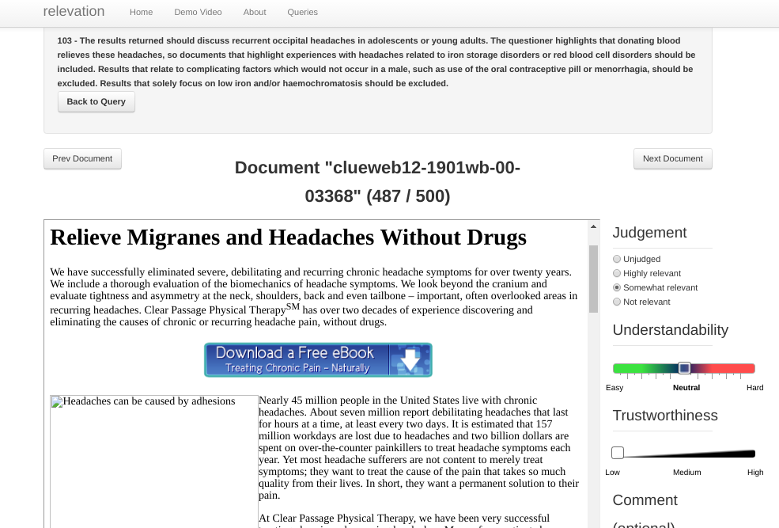
Relevation
Medical experts judged documents using the online interface Relevation: https://github.com/ielab/relevation
Assessed:
Topical relevance (based on criteria given)
Understandability
Trustworthiness

Slide 9
Baselines
IRTask1:
Most used models of Terrier and Indri (TF-IDF, BM25, LM…)
Both with and without query expansion
IRTask2:
Concatenated all query variants
Combined the query variants with some fusion method (RRF and RBP)

Slide 10
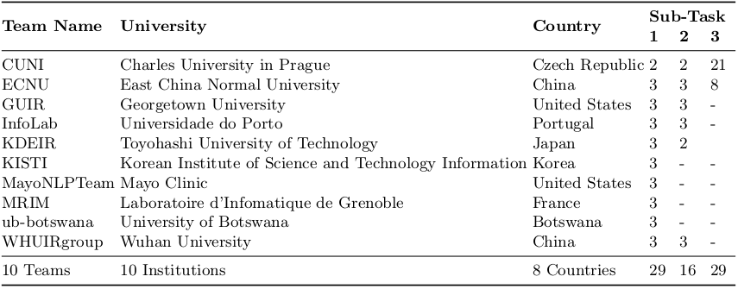
Participants

Slide 11
Pools
Multiplicative issue with query variation
Small intersection of returned results among query variations
Pool with only top 10 results for every run would have a huge size (~65k)
Solution was to use a fusion method to develop the pool. See [1]
[1] Lipani et al. "The Impact of Fixed-Cost Pooling Strategies on Test “. ICTIR 2016

Slide 12
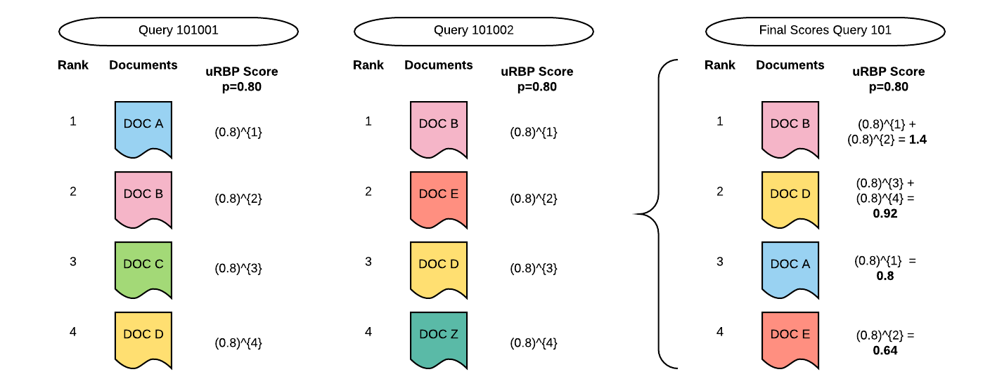
Pools
Tell how we did it. Biases. Coverage graph.

Slide 13
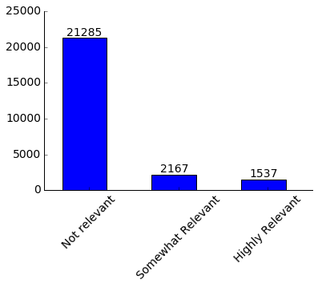
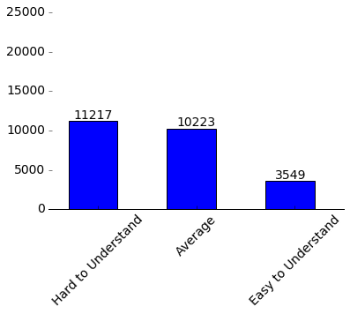
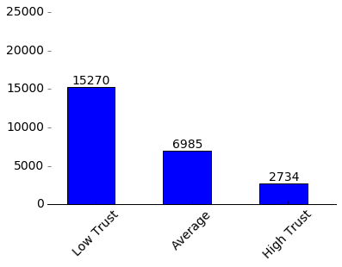
Pool Analysis

Slide 14
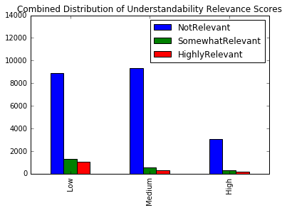
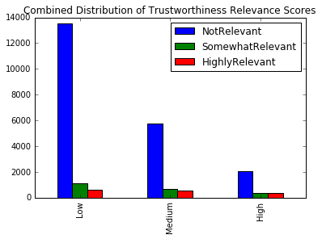
Pool Analysis

Slide 15
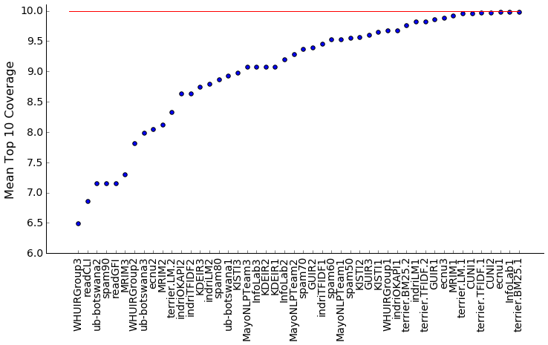
Pools
Coverage
Task 1

Slide 16
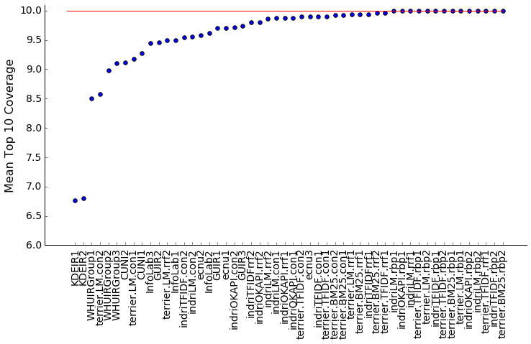
Pools
Coverage
Task 2

Slide 17
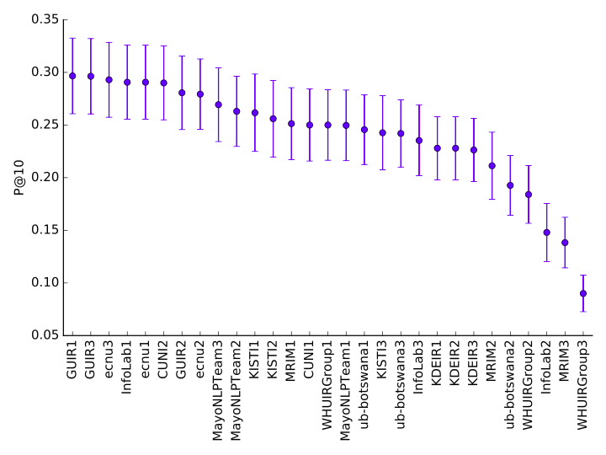
Result
P@10
Task 1

Slide 18
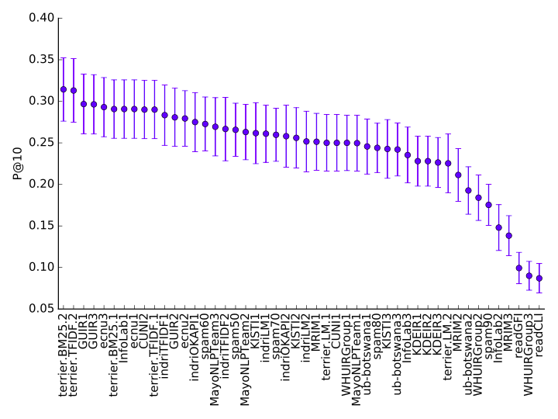
Result
P@10
Task 1

Slide 19
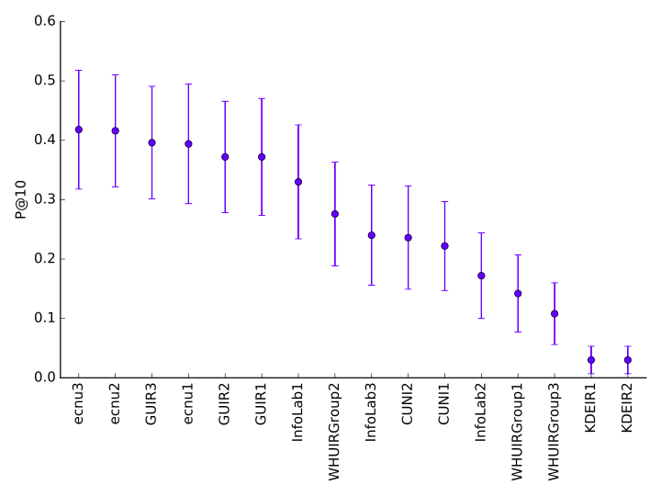
Result
P@10
Task 2

Slide 20
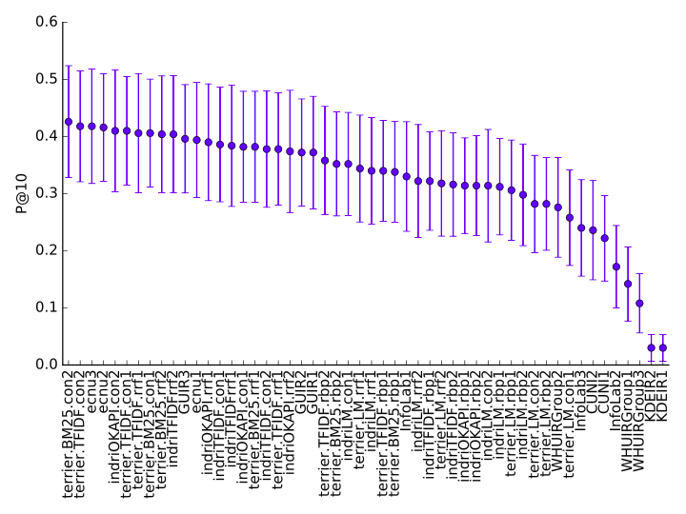
Result
P@10
Task 2

Slide 21
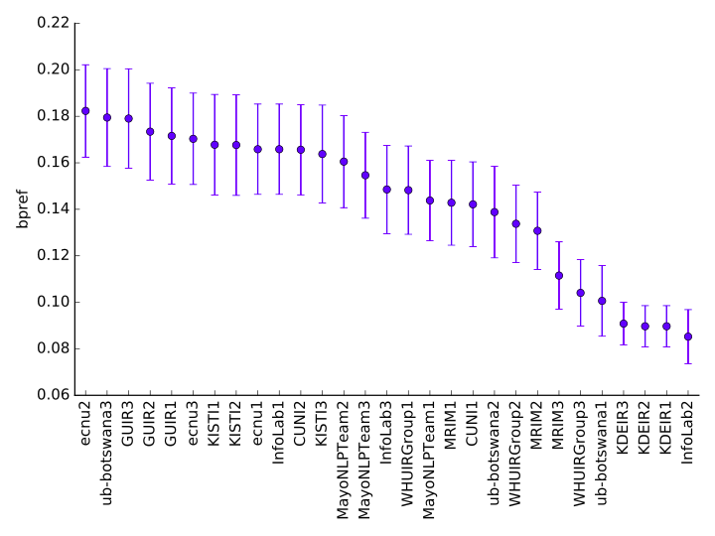
Result
BPref
Task 1

Slide 22
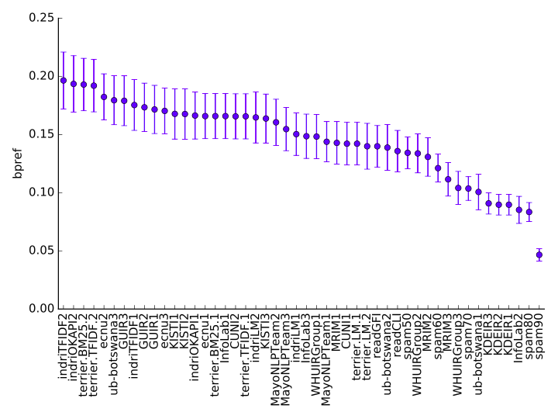
Result
BPref
Task 1

Slide 23
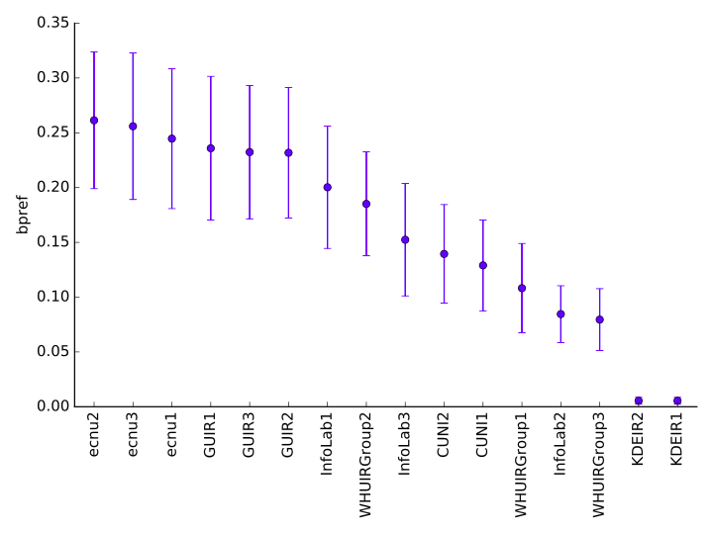
Result
BPref
Task 2

Slide 24
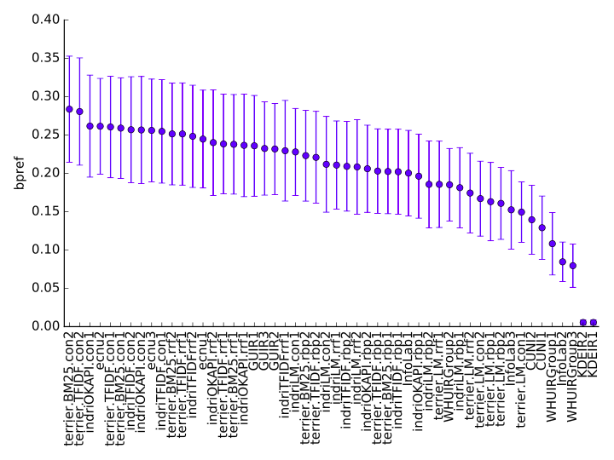
Result
BPref
Task 2

Slide 25
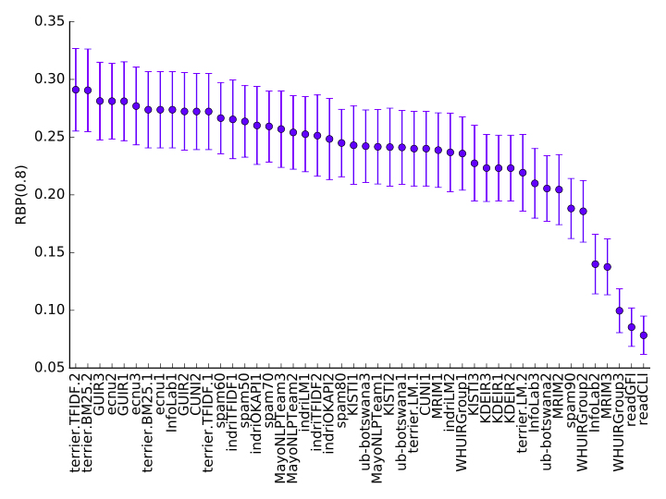
Result
RBP(0.8)
Task 1

Slide 26
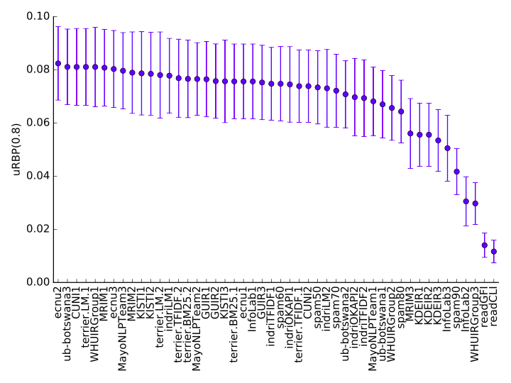
Result
uRBP
Task 1

Slide 27
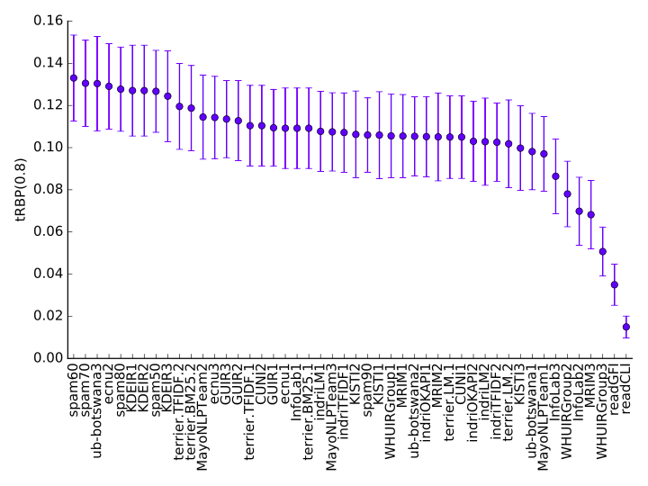
Result
tRBP
Task 1

Slide 28
Conclusion
We wish you had a nice time participating in the task Thanks everybody!
The task is much more complicated than it looks Probably many questions are asked because people could not find relevant documents on the Web
We want to make the task better Suggestions are HIGHLY appreciated!

Slide 29

Thanks
...wish to see you all in CLEF 2017!
joaopalotti.com

